Slide 1



Slide 2
Git and Github
Presented by
Amrita Shrestha and Swikriti Tripathi
JankariTech Pvt. Ltd.

Slide 3
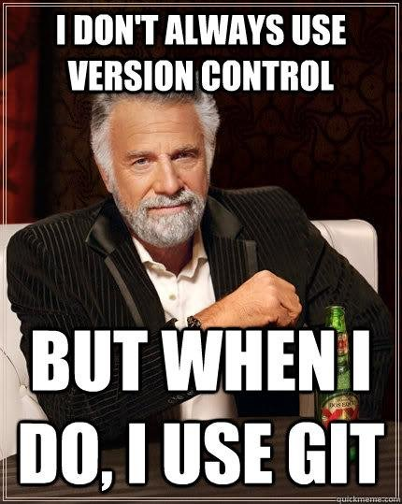

Slide 4
Version Control
Track and manage source code changes
Record all the changes - versions
Types:
Centralized Version Control System (CVCS)
Distributed Version Control System (DVCS)

Slide 5
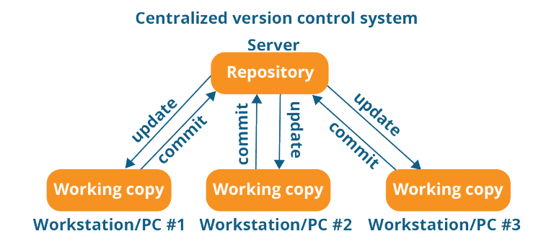

Slide 6
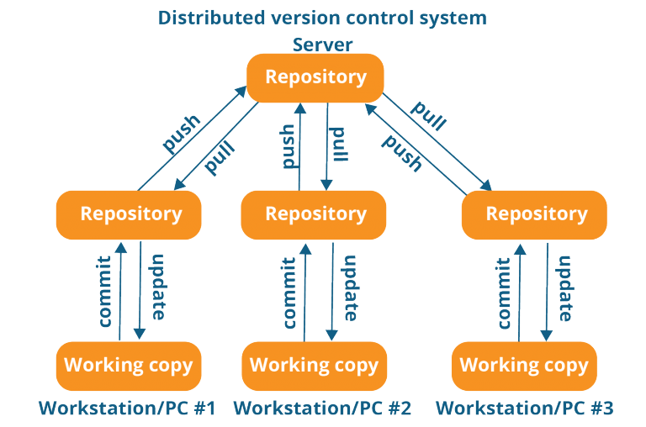

Slide 7
Git
Version control system
Tracking code changes
Tracking who made changes
Coding collaboration
Clone, push, commit, pull

Slide 8
GitHub
a Git repository hosting service
an online database to track and share projects
cloud-based
Coding collaboration
Fork, merge, pull request, code reviews

Slide 9
Why?
Worldwide usage
Code collaboration from anywhere
See the full history of the project
Revert to the earlier version

Slide 10
Create a Github account
https://github.com/

Slide 11
Git Installation
https://git-scm.com/downloads

Slide 12
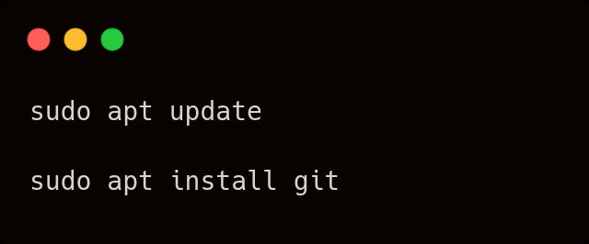
Git installation for Linux

Slide 13
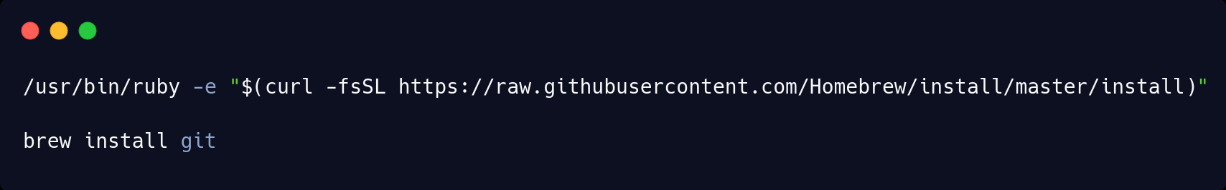
Git installation for mac

Slide 14
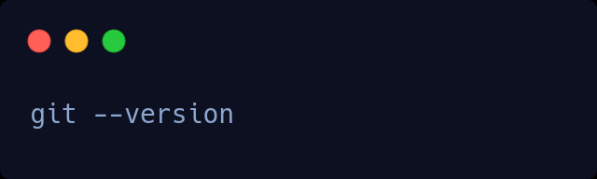
Checking Git Installation

Slide 15
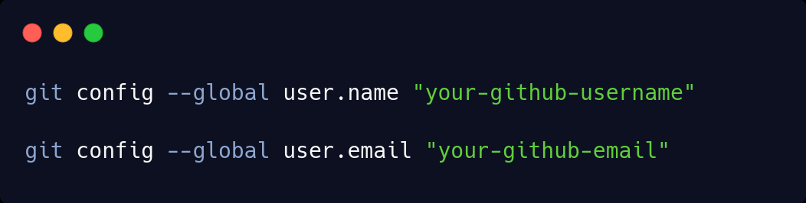
Git Configuration

Slide 16
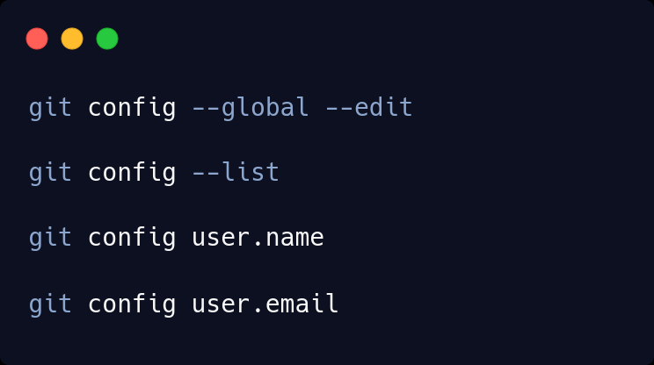
Git Configuration

Slide 17

Try out some git commands

Slide 18
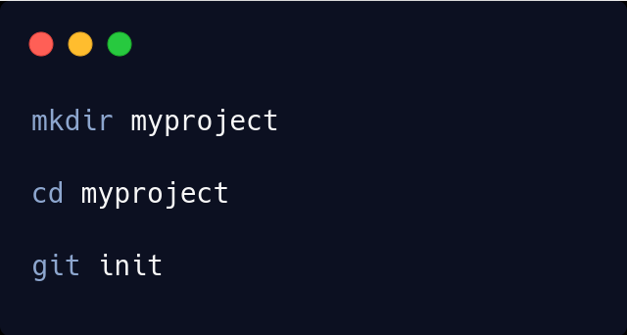
Git initialization

Slide 19
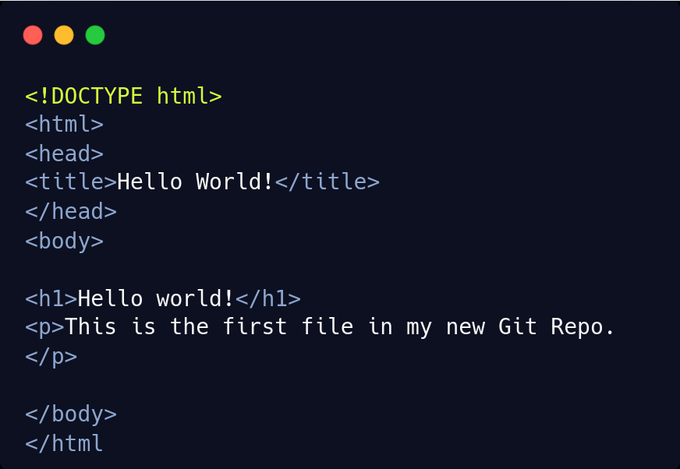
Add a file

Slide 20

Check status

Slide 21
States of files
Tracked : files that Git knows about and are added to the repository
Untracked : files that are in your working directory, but not added to the repository

Slide 22
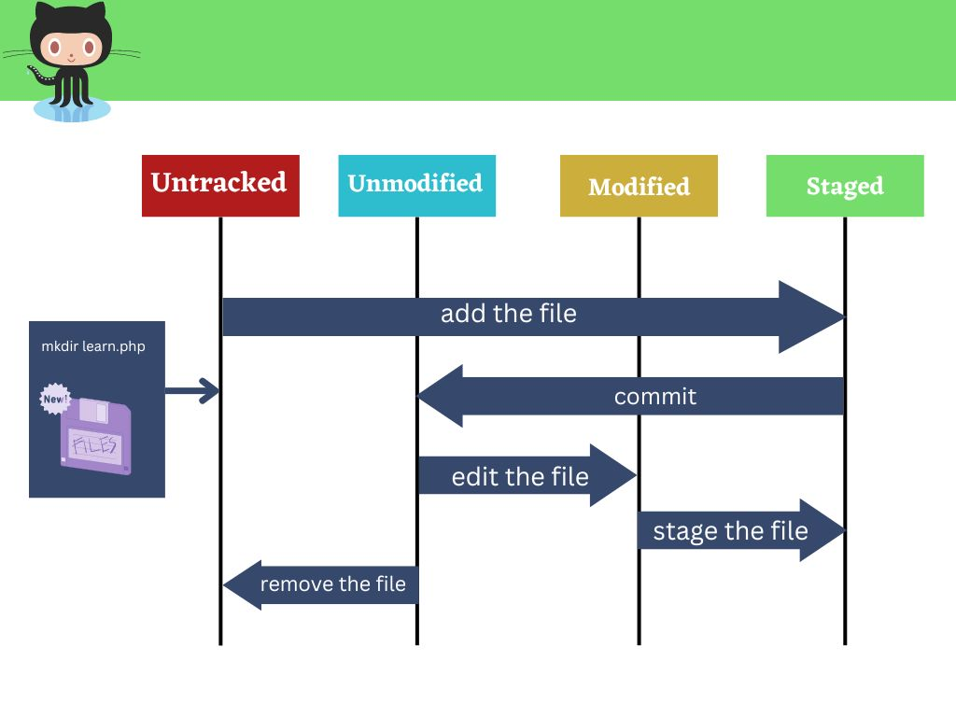
File Stages
Notes:
https://carbon.now.sh/?bg=rgba%280%2C0%2C0%2C1%29&t=blackboard&wt=none&l=application%2Fx-sh&width=436&ds=true&dsyoff=20px&dsblur=68px&wc=true&wa=false&pv=0px&ph=0px&ln=false&fl=1&fm=Hack&fs=14px&lh=133%25&si=false&es=2x&wm=false&code=git%2520status

Slide 23
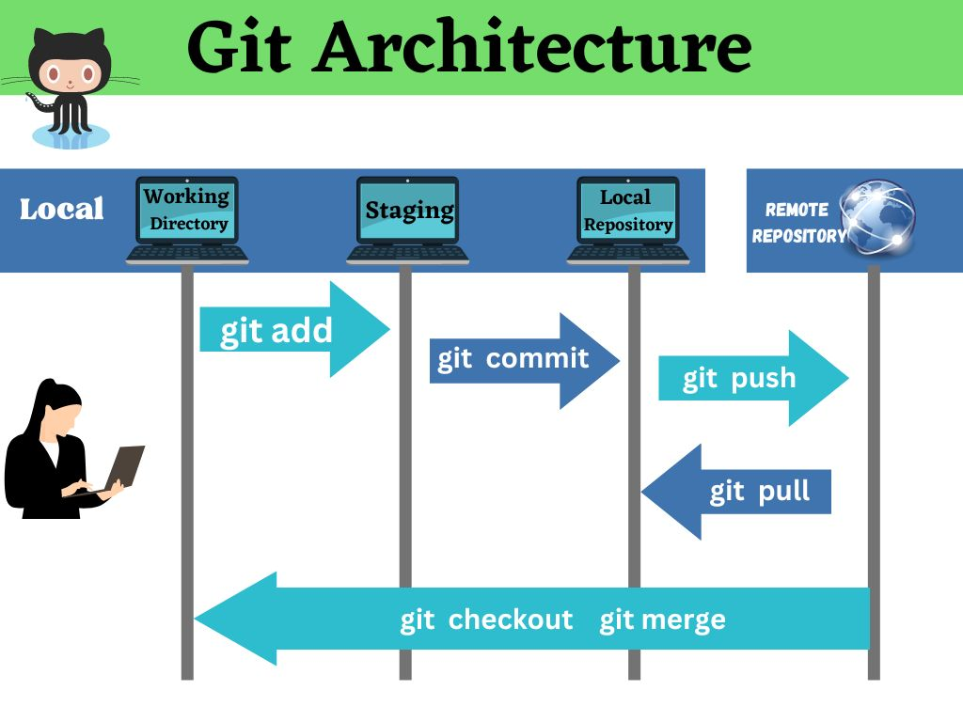
Notes:
https://carbon.now.sh/?bg=rgba%280%2C0%2C0%2C1%29&t=blackboard&wt=none&l=application%2Fx-sh&width=436&ds=true&dsyoff=20px&dsblur=68px&wc=true&wa=false&pv=0px&ph=0px&ln=false&fl=1&fm=Hack&fs=14px&lh=133%25&si=false&es=2x&wm=false&code=git%2520status

Slide 24
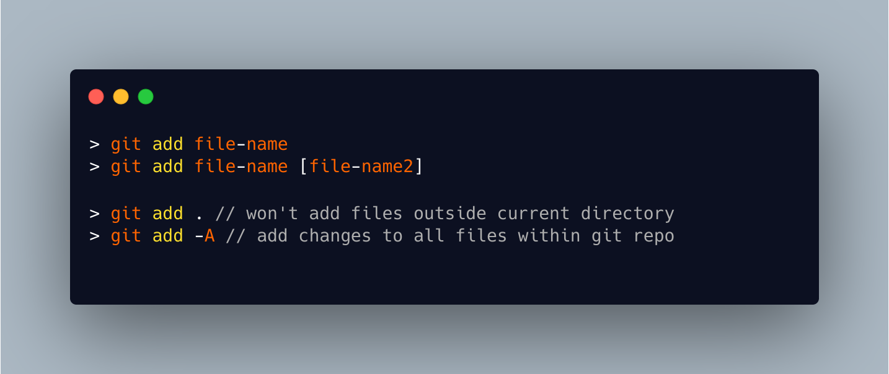
Add File to Repository

Slide 25
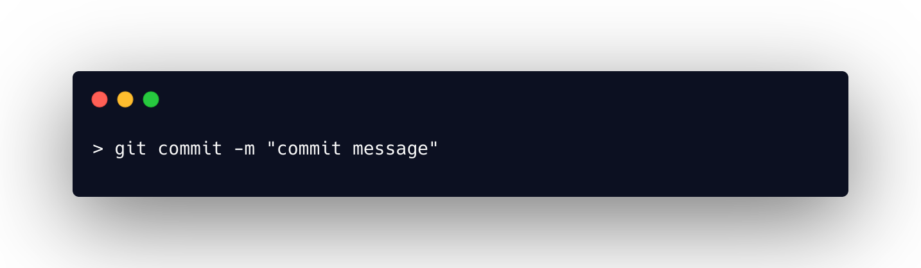
Commit Changes

Slide 26
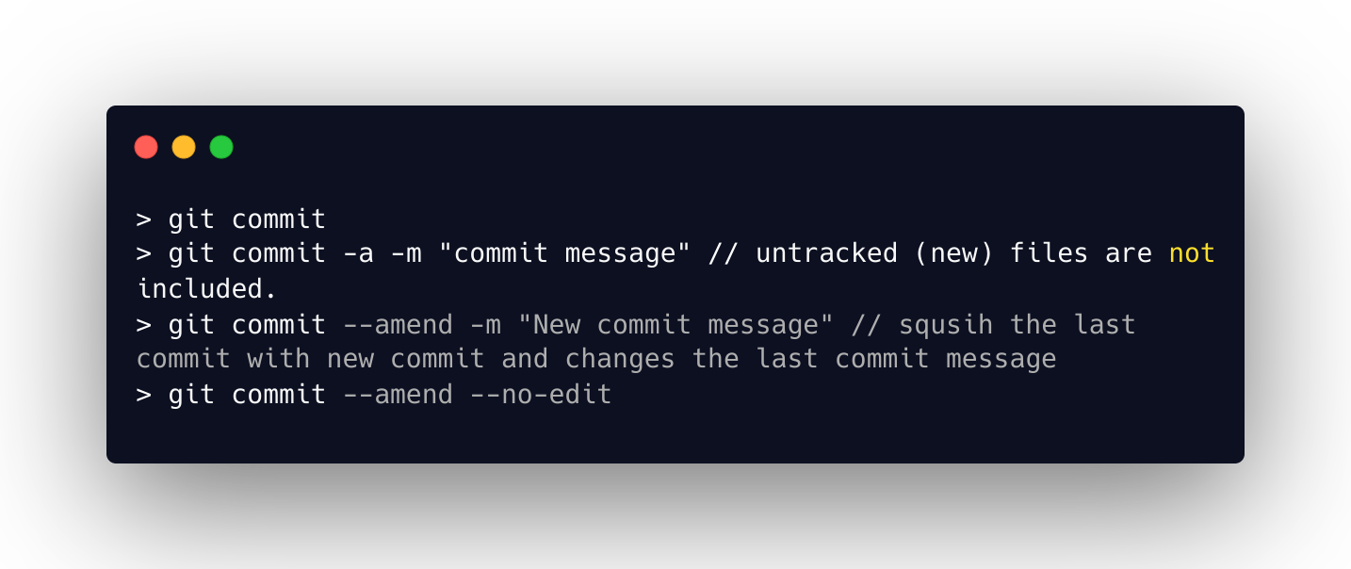

Slide 27
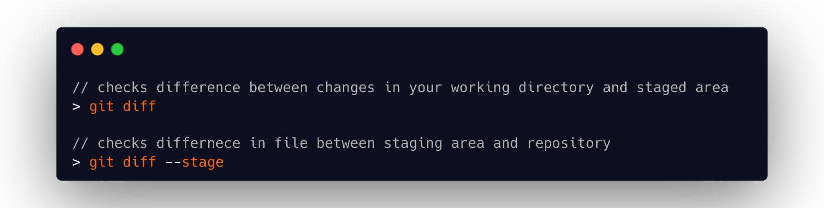
Compare changes

Slide 28
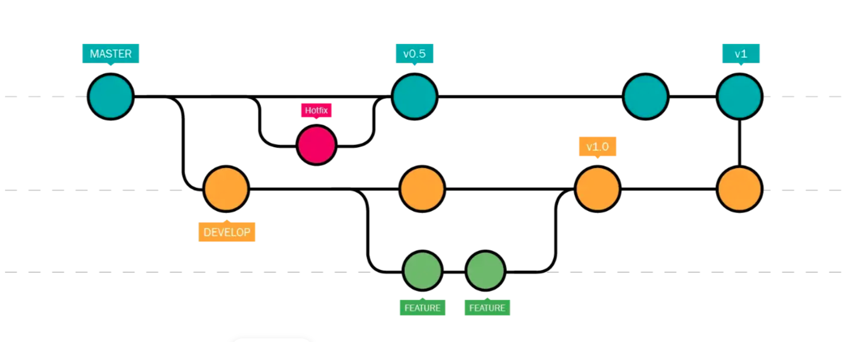
Branches

Slide 29
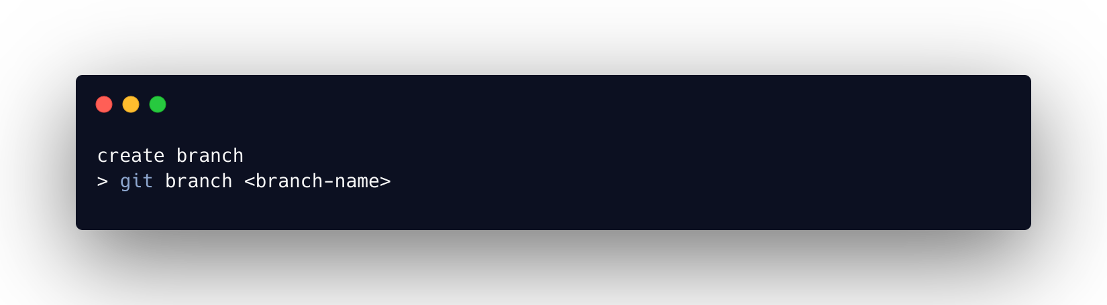

Slide 30
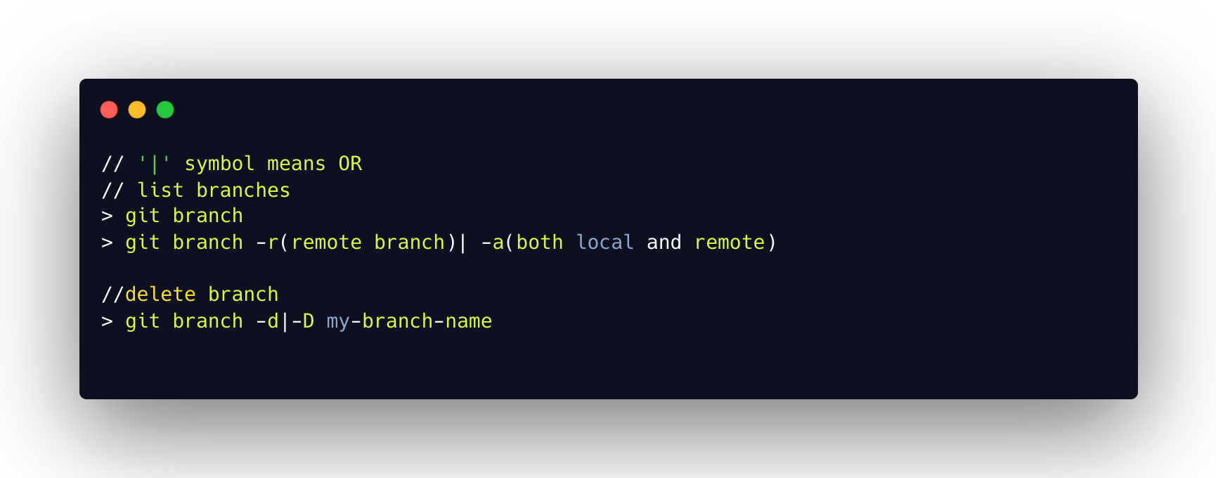

Slide 31
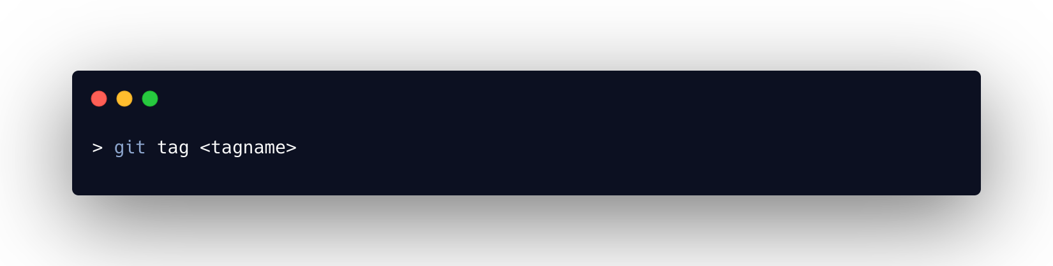
Tags
Tags are a symbolic name given to a specific commit
always point to the same object and do not change

Slide 32
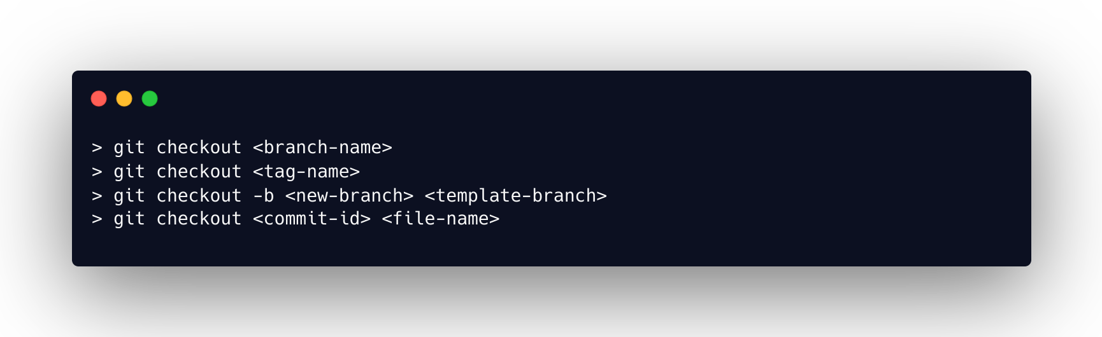
Switching Branches

Slide 33
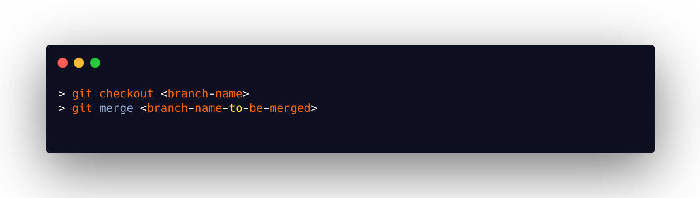
Merging

Slide 34
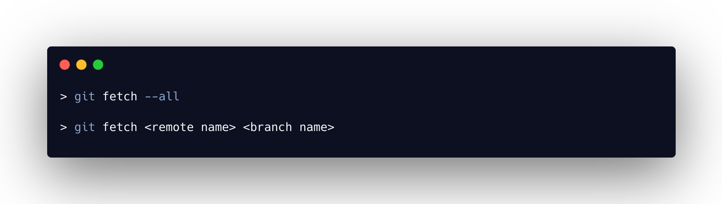
Git Pull and Git fetch
`git pull` download the remote content and execute `git merge`
`git fetch`download the remote content but not update your local repo's working state, leaving your current work intact

Slide 35
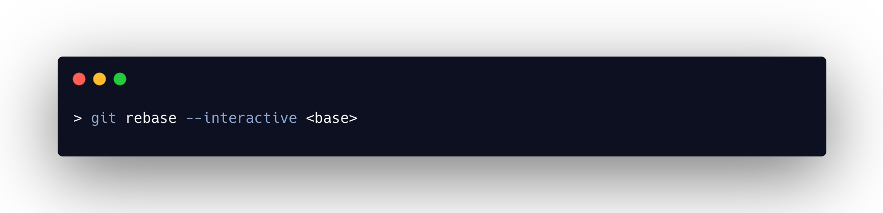
Rebase and Conflict

Slide 36
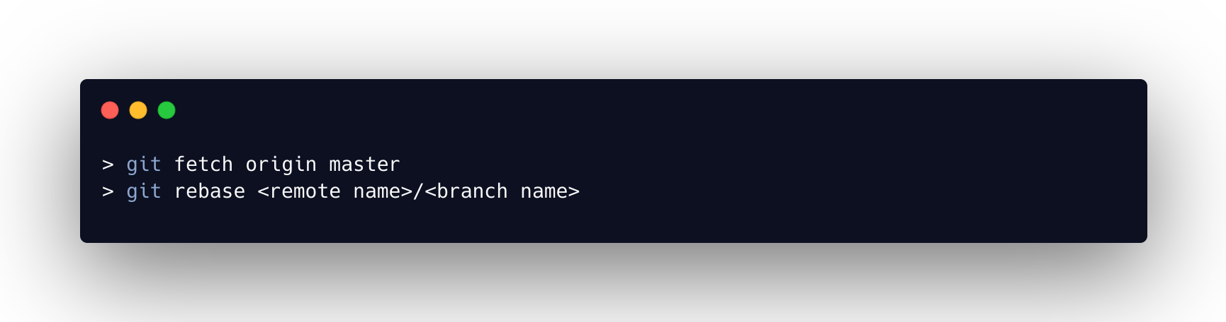

Slide 37
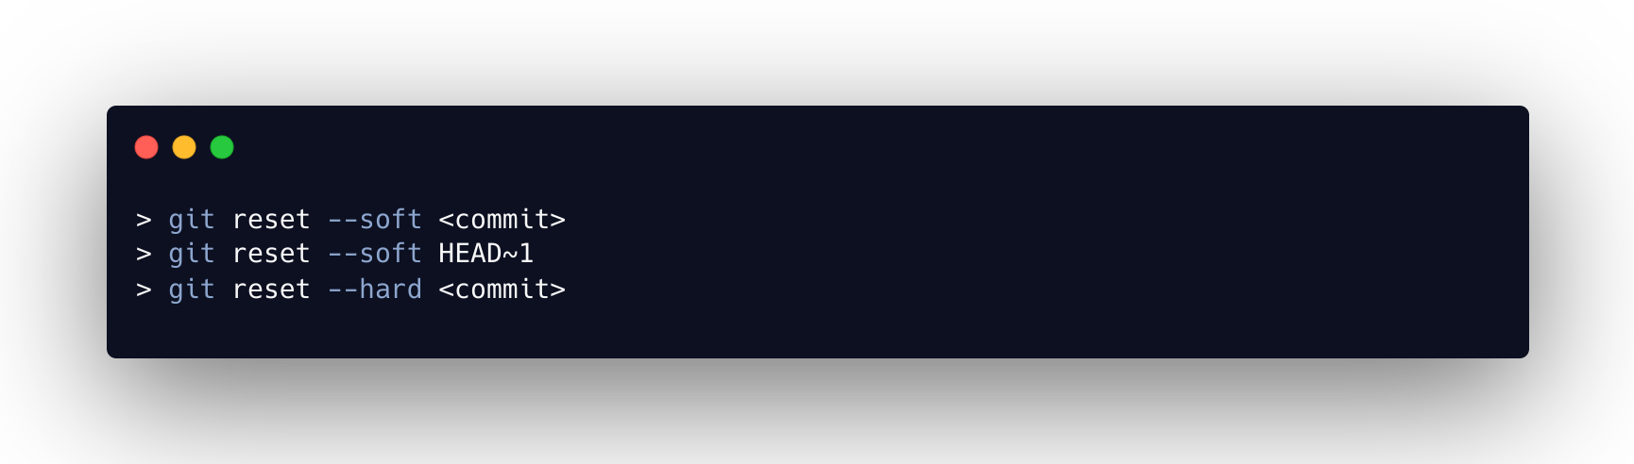
Undo Mistakes
Reset

Slide 38
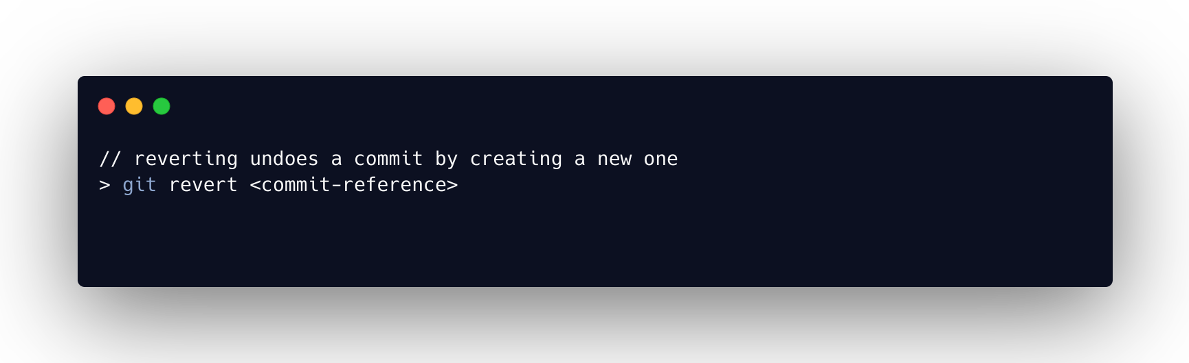
Revert

Slide 39
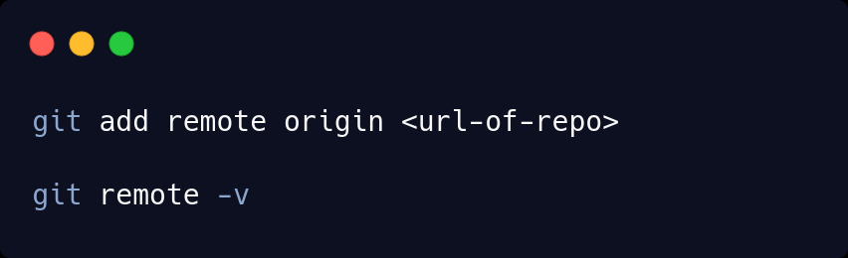
Add remote

Slide 40
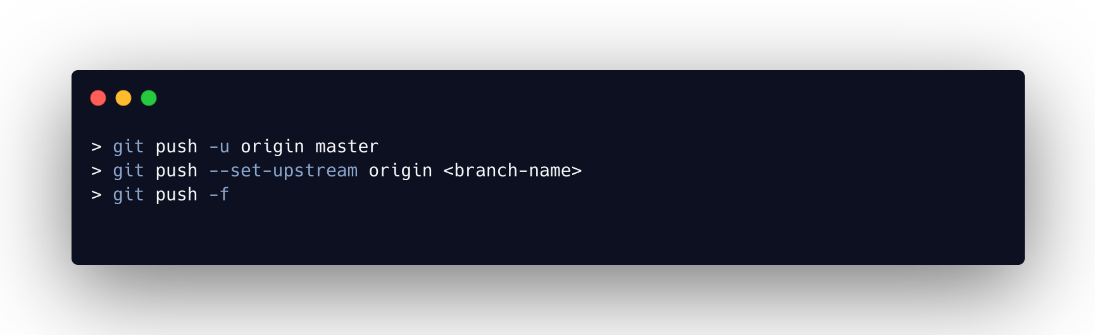
Push Local Changes to Remote

Slide 41
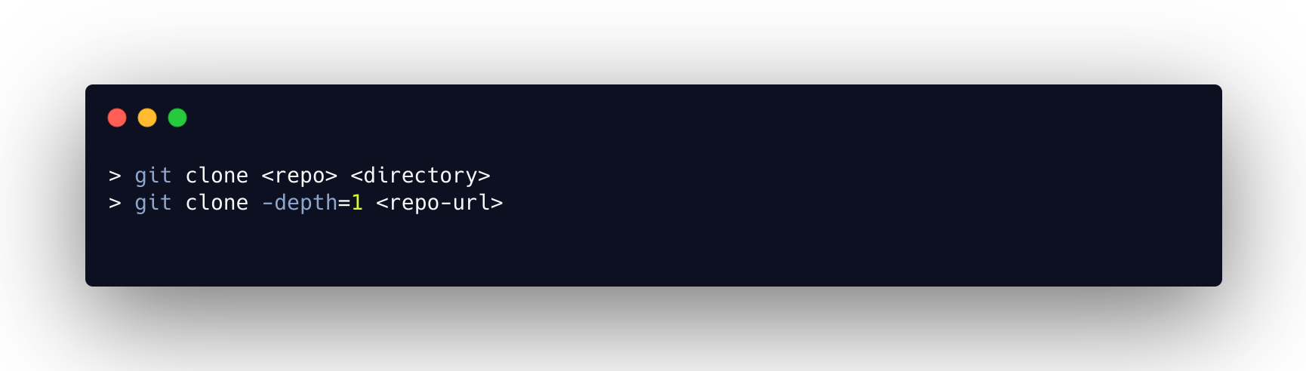
Clone Remote Repository

Slide 42
Bonus
Issue
Pull Request
Contribute in open source project

Slide 44
Thank You !

